Slide 1
Chapter 9: Virtual Memory

Slide 2
Chapter 9: Virtual Memory
Background
Demand Paging
Page Replacement
Allocation of Frames
Thrashing

Slide 3
Objectives
To describe the benefits of a virtual memory system
To explain the concepts of demand paging, page-replacement algorithms, and allocation of page frames
To discuss the principle of the working-set model

Slide 4
Background
Code needs to be in memory to execute, but entire program rarely used
  Error code, unusual routines, large data structures
Entire program code not needed at same time
Consider ability to execute partially-loaded program
  Program no longer constrained by limits of physical memory
  Program and programs could be larger than physical memory

Slide 5
Background
Virtual memory – separation of user logical memory from physical memory
  Only part of the program needs to be in memory for execution
  Logical address space can therefore be much larger than physical address space
  Allows address spaces to be shared by several processes
  Allows for more efficient process creation
  More programs running concurrently
  Less I/O needed to load or swap processes
Virtual memory can be implemented via:
  Demand paging
  Demand segmentation

Slide 6

Virtual Memory That is
Larger Than Physical Memory

Slide 7
Demand Paging
Could bring entire process into memory at load time
Or bring a page into memory only when it is needed
  Less I/O needed, no unnecessary I/O
  Less memory needed
  Faster response
  More users
Page is needed ⇒ reference to it
  invalid reference ⇒ abort
  not-in-memory ⇒ bring to memory
Lazy swapper – never swaps a page into memory unless page will be needed
  Swapper that deals with pages is a pager

Slide 8

Transfer of a Paged Memory to
Contiguous Disk Space

Slide 9
Valid-Invalid Bit
With each page table entry a valid–invalid bit is associated
(v ⇒ in-memory – memory resident, i ⇒ not-in-memory)
Initially valid–invalid bit is set to i on all entries
Example of a page table snapshot:
During address translation, if valid–invalid bit in page table entry
is I ⇒ page fault
Frame #
valid-invalid bit
v
v
v
v
i
….
i
i
page table

Slide 10

Page Table When Some Pages
Are Not in Main Memory

Slide 11
Page Fault
If there is a reference to a page, first reference to that page will trap to operating system:
page fault
Operating system looks at another table to decide:
  Invalid reference ⇒ abort
  Just not in memory
Get empty frame
Swap page into frame via scheduled disk operation
Reset tables to indicate page now in memory
Set validation bit = v
Restart the instruction that caused the page fault

Slide 12
Aspects of Demand Paging
Extreme case – start process with no pages in memory
  OS sets instruction pointer to first instruction of process, non-memory-resident -> page fault
  And for every other process pages on first access
  Pure demand paging
Actually, a given instruction could access multiple pages -> multiple page faults
  Pain decreased because of locality of reference
Hardware support needed for demand paging
  Page table with valid / invalid bit
  Secondary memory (swap device with swap space)
  Instruction restart

Slide 13
Instruction Restart
Consider an instruction that could access several different locations
  block move
  auto increment/decrement location
  Restart the whole operation?
    What if source and destination overlap?

Slide 14

Steps in Handling a Page Fault

Slide 15
Performance of Demand Paging
Stages in Demand Paging
Trap to the operating system
Save the user registers and process state
Determine that the interrupt was a page fault
Check that the page reference was legal and determine the location of the page on the disk
Issue a read from the disk to a free frame:
  Wait in a queue for this device until the read request is serviced
  Wait for the device seek and/or latency time
  Begin the transfer of the page to a free frame
While waiting, allocate the CPU to some other user
Receive an interrupt from the disk I/O subsystem (I/O completed)
Save the registers and process state for the other user
Determine that the interrupt was from the disk
Correct the page table and other tables to show page is now in memory
Wait for the CPU to be allocated to this process again
Restore the user registers, process state, and new page table, and then resume the interrupted instruction

Slide 16
Page Replacement
Prevent over-allocation of memory by modifying page-fault service routine to include page replacement
Use modify (dirty) bit to reduce overhead of page transfers – only modified pages are written to disk
Page replacement completes separation between logical memory and physical memory – large virtual memory can be provided on a smaller physical memory

Slide 17

Need For Page Replacement

Slide 18
Basic Page Replacement
Find the location of the desired page on disk
Find a free frame:
- If there is a free frame, use it
- If there is no free frame, use a page replacement algorithm to select a victim frame
- Write victim frame to disk if dirty
Bring the desired page into the (newly) free frame; update the page and frame tables
Continue the process by restarting the instruction that caused the trap
Note now potentially 2 page transfers for page fault – increasing EAT

Slide 19

Page Replacement

Slide 20
Page and Frame Replacement Algorithms
Frame-allocation algorithm determines
  How many frames to give each process
  Which frames to replace
Page-replacement algorithm
  Want lowest page-fault rate on both first access and re-access
Evaluate algorithm by running it on a particular string of memory references (reference string) and computing the number of page faults on that string
  String is just page numbers, not full addresses
  Repeated access to the same page does not cause a page fault
In all our examples, the reference string is
7,0,1,2,0,3,0,4,2,3,0,3,0,3,2,1,2,0,1,7,0,1

Slide 21

Graph of Page Faults Versus
The Number of Frames

Slide 22
First-In-First-Out (FIFO) Algorithm
Reference string: 7,0,1,2,0,3,0,4,2,3,0,3,0,3,2,1,2,0,1,7,0,1
3 frames (3 pages can be in memory at a time per process)
Can vary by reference string: consider 1,2,3,4,1,2,5,1,2,3,4,5
  Adding more frames can cause more page faults!
    Belady’s Anomaly
How to track ages of pages?
  Just use a FIFO queue
1
7
2
4 0 7
2
0
3
15 page faults
2 1 0
3
1
0
3 2 1

Slide 23
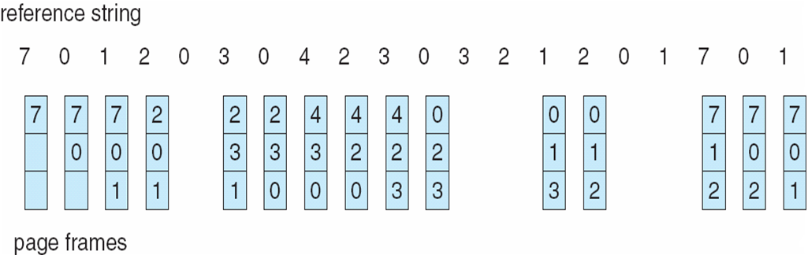
FIFO Page Replacement

Slide 24
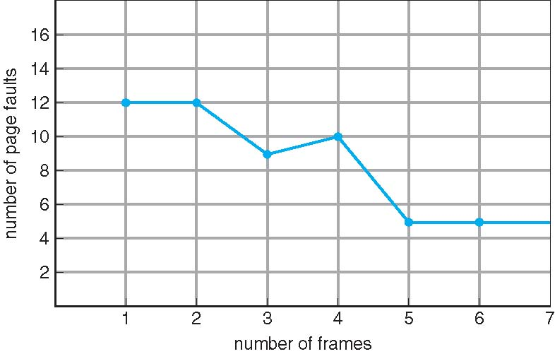
FIFO Illustrating Belady’s Anomaly

Slide 25
Optimal Algorithm
Replace page that will not be used for longest period of time
  9 is optimal for the example on the next slide
How do you know this?
  Can’t read the future
Used for measuring how well your algorithm performs

Slide 26
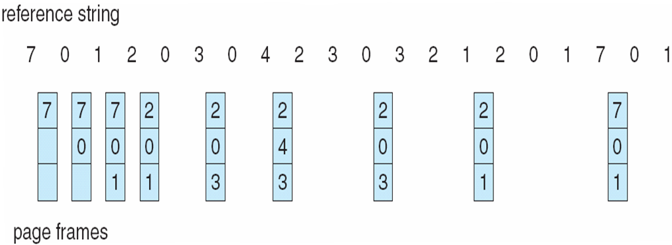
Optimal Page Replacement

Slide 27

Least Recently Used (LRU) Algorithm
Use past knowledge rather than future
Replace page that has not been used in the most amount of time
Associate time of last use with each page
12 faults – better than FIFO but worse than OPT
Generally good algorithm and frequently used
But how to implement?

Slide 28
LRU Algorithm (Cont.)
Counter implementation
  Every page entry has a counter; every time page is referenced through this entry, copy the clock into the counter
  When a page needs to be changed, look at the counters to find smallest value
    Search through table needed
Stack implementation
  Keep a stack of page numbers in a double link form:
  Page referenced:
    move it to the top
    requires 6 pointers to be changed
  But each update more expensive
  No search for replacement
LRU and OPT are cases of stack algorithms that don’t have Belady’s Anomaly

Slide 29
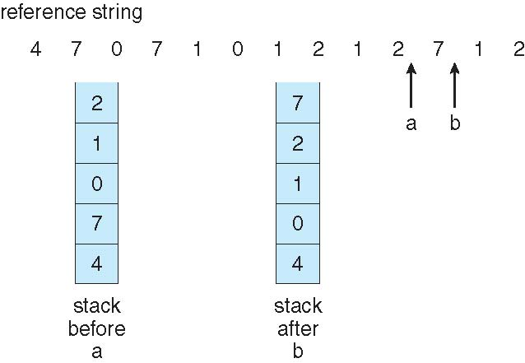
Use Of A Stack to Record The
Most Recent Page References

Slide 30
LRU Approximation Algorithms
LRU needs special hardware and still slow
Reference bit
  With each page associate a bit, initially = 0
  When page is referenced bit set to 1
  Replace any with reference bit = 0 (if one exists)
    We do not know the order, however
Second-chance algorithm
  Generally FIFO, plus hardware-provided reference bit
  Clock replacement
  If page to be replaced has
    Reference bit = 0 -> replace it
    reference bit = 1 then:
      set reference bit 0, leave page in memory
      replace next page, subject to same rules

Slide 31
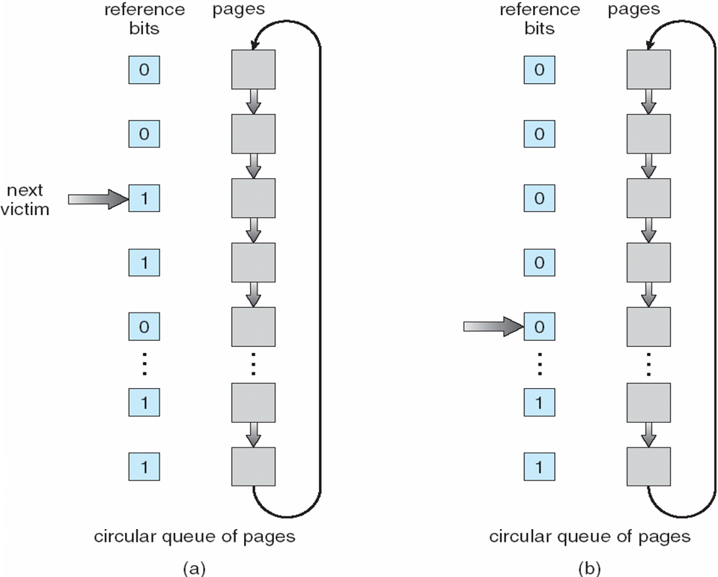
Second-Chance (clock) Page-Replacement Algorithm

Slide 32
Applications and Page Replacement
All of these algorithms have OS guessing about future page access
Some applications have better knowledge – i.e. databases
Memory intensive applications can cause double buffering
  OS keeps copy of page in memory as I/O buffer
  Application keeps page in memory for its own work
Operating system can given direct access to the disk, getting out of the way of the applications
  Raw disk mode
Bypasses buffering, locking, etc

Slide 33
Non-Uniform Memory Access
So far all memory accessed equally
Many systems are NUMA – speed of access to memory varies
  Consider system boards containing CPUs and memory, interconnected over a system bus
Optimal performance comes from allocating memory “close to” the CPU on which the thread is scheduled
  And modifying the scheduler to schedule the thread on the same system board when possible
  Solved by Solaris by creating lgroups
    Structure to track CPU / Memory low latency groups
    Used my schedule and pager
    When possible schedule all threads of a process and allocate all memory for that process within the lgroup

Slide 34
Thrashing
If a process does not have “enough” pages, the page-fault rate is very high
  Page fault to get page
  Replace existing frame
  But quickly need replaced frame back
  This leads to:
    Low CPU utilization
    Operating system thinking that it needs to increase the degree of multiprogramming
    Another process added to the system
Thrashing ≡ a process is busy swapping pages in and out

Slide 35

Thrashing (Cont.)

Slide 36
Demand Paging and Thrashing
Why does demand paging work?
Locality model
  Process migrates from one locality to another
  Localities may overlap
Why does thrashing occur?
Σ size of locality > total memory size
  Limit effects by using local or priority page replacement

Slide 37
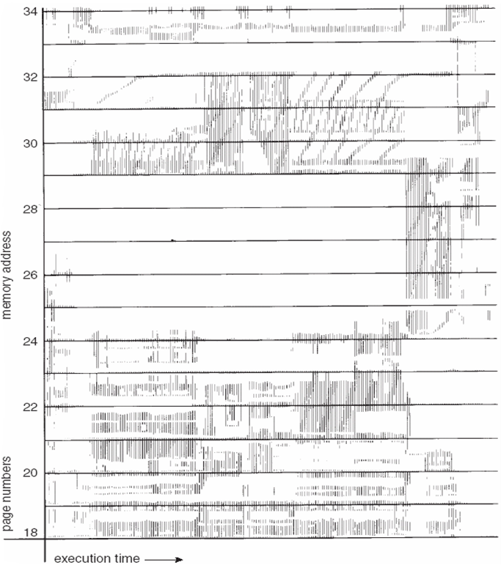
Locality In A Memory-Reference Pattern

Slide 38
Working-Set Model
Δ ≡ working-set window ≡ a fixed number of page references
Example: 10,000 instructions
WSS_{i} (working set of Process P_{i}) =
total number of pages referenced in the most recent Δ (varies in time)
  if Δ too small will not encompass entire locality
  if Δ too large will encompass several localities
  if Δ = ∞ ⇒ will encompass entire program
D = Σ WSS_{i} ≡ total demand frames
  Approximation of locality
if D > m ⇒ Thrashing
Policy if D > m, then suspend or swap out one of the processes

Slide 39

Working-set model

Slide 40
Keeping Track of the Working Set
Approximate with interval timer + a reference bit
Example: Δ = 10,000
  Timer interrupts after every 5000 time units
  Keep in memory 2 bits for each page
  Whenever a timer interrupts copy and sets the values of all reference bits to 0
  If one of the bits in memory = 1 ⇒ page in working set
Why is this not completely accurate?
Improvement = 10 bits and interrupt every 1000 time units

Slide 41
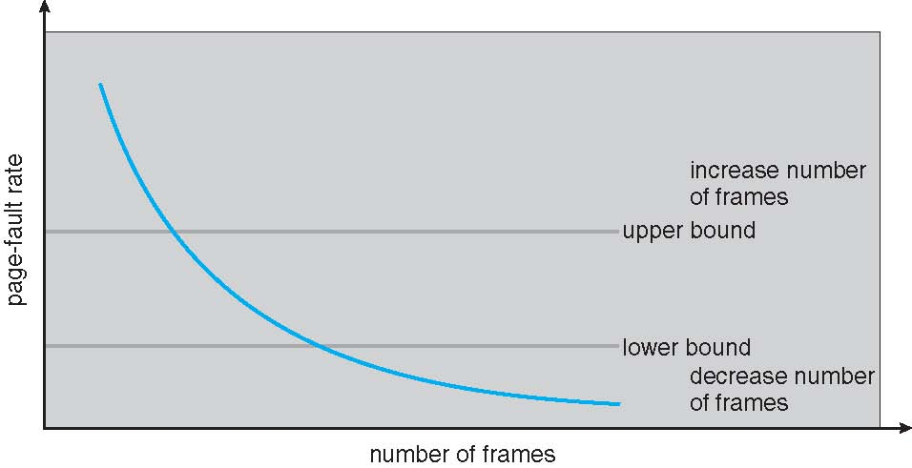
Page-Fault Frequency
More direct approach than WSS
Establish “acceptable” page-fault frequency rate and use local replacement policy
  If actual rate too low, process loses frame
  If actual rate too high, process gains frame

